Slide 1
“Multiple
Magnifying Glasses”
Steve Wyborney
www.stevewyborney.com

Slide 2
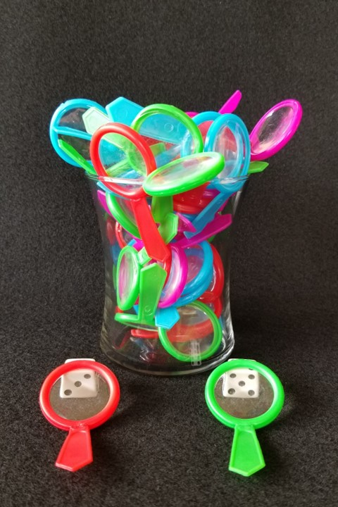
How many magnifying glasses are there? That includes the ones in front of the vase.
As the clues appear, use the information to narrow the possibilities to a smaller set. After each clue, use estimation again to determine which of the remaining answers is the most reasonable.
Write down your first estimate. After each clue, you’ll see if your estimate is still a possibility. After each clue, if it is no longer possible write down a new estimate – and be prepared to explain why you chose it.
Steve Wyborney
www.stevewyborney.com

Slide 3
How many magnifying glasses are there?
That includes the ones in front of the vase.
Clue #1
Clue #1
The answer is between 40 and 90.
Clue #2
Clue #2
There is a clue in the
green magnifying glass.
The answer is a multiple of 5.
Clue #3
Clue #3
There is a clue in the
red magnifying glass.
The answer is a multiple of 3.
Clue #4
Clue #4
The answer is not a multiple of 10.
41 | 42 | 43 | 44 | 45 | 46 | 47 | 48 | 49 | 50
51 | 52 | 53 | 54 | 55 | 56 | 57 | 58 | 59 | 60
61 | 62 | 63 | 64 | 65 | 66 | 67 | 68 | 69 | 70
71 | 72 | 73 | 74 | 75 | 76 | 77 | 78 | 79 | 80
81 | 82 | 83 | 84 | 85 | 86 | 87 | 88 | 89 | 90
41 | 42 | 43 | 44 | 45 | 46 | 47 | 48 | 49 | 50
51 | 52 | 53 | 54 | 55 | 56 | 57 | 58 | 59 | 60
61 | 62 | 63 | 64 | 65 | 66 | 67 | 68 | 69 | 70
71 | 72 | 73 | 74 | 75 | 76 | 77 | 78 | 79 | 80
81 | 82 | 83 | 84 | 85 | 86 | 87 | 88 | 89 | 90
41 | 42 | 43 | 44 | 45 | 46 | 47 | 48 | 49 | 50
51 | 52 | 53 | 54 | 55 | 56 | 57 | 58 | 59 | 60
61 | 62 | 63 | 64 | 65 | 66 | 67 | 68 | 69 | 70
71 | 72 | 73 | 74 | 75 | 76 | 77 | 78 | 79 | 80
81 | 82 | 83 | 84 | 85 | 86 | 87 | 88 | 89 | 90
41 | 42 | 43 | 44 | 45 | 46 | 47 | 48 | 49 | 50
51 | 52 | 53 | 54 | 55 | 56 | 57 | 58 | 59 | 60
61 | 62 | 63 | 64 | 65 | 66 | 67 | 68 | 69 | 70
71 | 72 | 73 | 74 | 75 | 76 | 77 | 78 | 79 | 80
81 | 82 | 83 | 84 | 85 | 86 | 87 | 88 | 89 | 90
41 | 42 | 43 | 44 | 45 | 46 | 47 | 48 | 49 | 50
51 | 52 | 53 | 54 | 55 | 56 | 57 | 58 | 59 | 60
61 | 62 | 63 | 64 | 65 | 66 | 67 | 68 | 69 | 70
71 | 72 | 73 | 74 | 75 | 76 | 77 | 78 | 79 | 80
81 | 82 | 83 | 84 | 85 | 86 | 87 | 88 | 89 | 90
Steve Wyborney
www.stevewyborney.com

Slide 4
After seeing the clues, you have narrowed the possibilities to a small set of numbers. Before you see the answer, select your final estimate. Write it down, and explain to someone why you chose that number.
Steve Wyborney
www.stevewyborney.com

Slide 5
45 magnifying glasses
The Reveal
Click to see the answer.
Steve Wyborney
www.stevewyborney.com

