Slide 1
“The Orange Creature is Looking Right at a Clue”
Important Note:
If you can see this box, then the slide show is not playing and the reveal won’t work.
Here is the solution:
If you are using PowerPoint,
click on Slide Show,
then click on From Current Slide.
If you are using Google Slides,
click on View then Present.
Steve Wyborney
www.stevewyborney.com

Slide 2
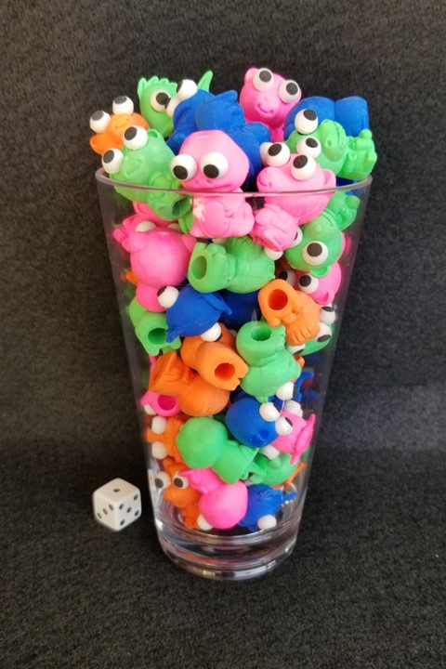
How many erasers are in the glass?
As the clues appear, use the information to narrow the possibilities to a smaller set. After each clue, use estimation again to determine which of the remaining answers is the most reasonable.
Write down your first estimate. After each clue, you’ll see if your estimate is still a possibility. After each clue, if it is no longer possible write down a new estimate – and be prepared to explain why you chose it.
Steve Wyborney
www.stevewyborney.com

Slide 3
Clue #1
Clue #1
The answer is a multiple of 4
that is between 30 and 70.
Clue #2
Clue #2
The orange creature at the bottom found a clue: The answer does not include the digit 3 or the digit 5.
Clue #3
Clue #3
The answer is not a multiple of 6.
Clue #4
Clue #4
Eliminate the number that is 4 times greater than 17.
Clue #5
Clue #5
The answer has 2 different digits.
31 | 32 | 33 | 34 | 35 | 36 | 37 | 38 | 39 | 40
41 | 42 | 43 | 44 | 45 | 46 | 47 | 48 | 49 | 50
51 | 52 | 53 | 54 | 55 | 56 | 57 | 58 | 59 | 60
61 | 62 | 63 | 64 | 65 | 66 | 67 | 68 | 69 | 70
31 | 32 | 33 | 34 | 35 | 36 | 37 | 38 | 39 | 40
41 | 42 | 43 | 44 | 45 | 46 | 47 | 48 | 49 | 50
51 | 52 | 53 | 54 | 55 | 56 | 57 | 58 | 59 | 60
61 | 62 | 63 | 64 | 65 | 66 | 67 | 68 | 69 | 70
31 | 32 | 33 | 34 | 35 | 36 | 37 | 38 | 39 | 40
41 | 42 | 43 | 44 | 45 | 46 | 47 | 48 | 49 | 50
51 | 52 | 53 | 54 | 55 | 56 | 57 | 58 | 59 | 60
61 | 62 | 63 | 64 | 65 | 66 | 67 | 68 | 69 | 70
31 | 32 | 33 | 34 | 35 | 36 | 37 | 38 | 39 | 40
41 | 42 | 43 | 44 | 45 | 46 | 47 | 48 | 49 | 50
51 | 52 | 53 | 54 | 55 | 56 | 57 | 58 | 59 | 60
61 | 62 | 63 | 64 | 65 | 66 | 67 | 68 | 69 | 70
31 | 32 | 33 | 34 | 35 | 36 | 37 | 38 | 39 | 40
41 | 42 | 43 | 44 | 45 | 46 | 47 | 48 | 49 | 50
51 | 52 | 53 | 54 | 55 | 56 | 57 | 58 | 59 | 60
61 | 62 | 63 | 64 | 65 | 66 | 67 | 68 | 69 | 70
31 | 32 | 33 | 34 | 35 | 36 | 37 | 38 | 39 | 40
41 | 42 | 43 | 44 | 45 | 46 | 47 | 48 | 49 | 50
51 | 52 | 53 | 54 | 55 | 56 | 57 | 58 | 59 | 60
61 | 62 | 63 | 64 | 65 | 66 | 67 | 68 | 69 | 70
Steve Wyborney
www.stevewyborney.com

Slide 4
After seeing the clues, you have narrowed the possibilities to a small set of numbers. Before you see the answer, select your final estimate. Write it down, and explain to someone why you chose that number.
Steve Wyborney
www.stevewyborney.com

Slide 5
64 erasers
The Reveal
Click to see the answer.
Important Note:
If you can see this box, then the slide show is not playing and the reveal won’t work.
Here is the solution:
If you are using PowerPoint,
click on Slide Show,
then click on From Current Slide.
If you are using Google Slides,
click on View then Present.
Steve Wyborney
www.stevewyborney.com

