Slide 1
“The Product of the Clues”
Steve Wyborney
www.stevewyborney.com

Slide 2
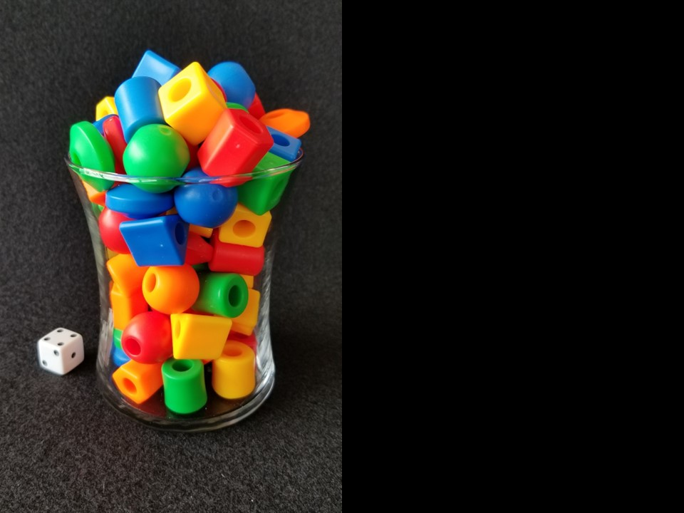
How many beads are in the vase?
As the clues appear, use the information to narrow the possibilities to a smaller set. After each clue, use estimation again to determine which of the remaining answers is the most reasonable.
Write down your first estimate. After each clue, you’ll see if your estimate is still a possibility. After each clue, if it is no longer possible write down a new estimate – and be prepared to explain why you chose it.
Steve Wyborney
www.stevewyborney.com

Slide 3
Clue #1
Clue #1
The answer is an odd number
between 20 and 80.
Clue #2
Clue #2
The answer is not a multiple of 3.
Clue #3
Clue #3
Eliminate 29 and the number that is 50 more than 29. Also eliminate the number that is 6 less than 29.
Clue #4
Clue #4
Multiply 6 × 8. Subtract from the product the number of pips (dots on the die) that can be seen in the picture.
Eliminate that number.
21 | 22 | 23 | 24 | 25 | 26 | 27 | 28 | 29 | 30
31 | 32 | 33 | 34 | 35 | 36 | 37 | 38 | 39 | 40
41 | 42 | 43 | 44 | 45 | 46 | 47 | 48 | 49 | 50
51 | 52 | 53 | 54 | 55 | 56 | 57 | 58 | 59 | 60
61 | 62 | 63 | 64 | 65 | 66 | 67 | 68 | 69 | 70
71 | 72 | 73 | 74 | 75 | 76 | 77 | 78 | 79 | 80
21 | 22 | 23 | 24 | 25 | 26 | 27 | 28 | 29 | 30
31 | 32 | 33 | 34 | 35 | 36 | 37 | 38 | 39 | 40
41 | 42 | 43 | 44 | 45 | 46 | 47 | 48 | 49 | 50
51 | 52 | 53 | 54 | 55 | 56 | 57 | 58 | 59 | 60
61 | 62 | 63 | 64 | 65 | 66 | 67 | 68 | 69 | 70
71 | 72 | 73 | 74 | 75 | 76 | 77 | 78 | 79 | 80
21 | 22 | 23 | 24 | 25 | 26 | 27 | 28 | 29 | 30
31 | 32 | 33 | 34 | 35 | 36 | 37 | 38 | 39 | 40
41 | 42 | 43 | 44 | 45 | 46 | 47 | 48 | 49 | 50
51 | 52 | 53 | 54 | 55 | 56 | 57 | 58 | 59 | 60
61 | 62 | 63 | 64 | 65 | 66 | 67 | 68 | 69 | 70
71 | 72 | 73 | 74 | 75 | 76 | 77 | 78 | 79 | 80
21 | 22 | 23 | 24 | 25 | 26 | 27 | 28 | 29 | 30
31 | 32 | 33 | 34 | 35 | 36 | 37 | 38 | 39 | 40
41 | 42 | 43 | 44 | 45 | 46 | 47 | 48 | 49 | 50
51 | 52 | 53 | 54 | 55 | 56 | 57 | 58 | 59 | 60
61 | 62 | 63 | 64 | 65 | 66 | 67 | 68 | 69 | 70
71 | 72 | 73 | 74 | 75 | 76 | 77 | 78 | 79 | 80
21 | 22 | 23 | 24 | 25 | 26 | 27 | 28 | 29 | 30
31 | 32 | 33 | 34 | 35 | 36 | 37 | 38 | 39 | 40
41 | 42 | 43 | 44 | 45 | 46 | 47 | 48 | 49 | 50
51 | 52 | 53 | 54 | 55 | 56 | 57 | 58 | 59 | 60
61 | 62 | 63 | 64 | 65 | 66 | 67 | 68 | 69 | 70
71 | 72 | 73 | 74 | 75 | 76 | 77 | 78 | 79 | 80
21 | 22 | 23 | 24 | 25 | 26 | 27 | 28 | 29 | 30
31 | 32 | 33 | 34 | 35 | 36 | 37 | 38 | 39 | 40
41 | 42 | 43 | 44 | 45 | 46 | 47 | 48 | 49 | 50
51 | 52 | 53 | 54 | 55 | 56 | 57 | 58 | 59 | 60
61 | 62 | 63 | 64 | 65 | 66 | 67 | 68 | 69 | 70
71 | 72 | 73 | 74 | 75 | 76 | 77 | 78 | 79 | 80
Clue #5
Clue #5
There are some remaining pairs of numbers that have a difference of 10.
Eliminate all those pairs.
Steve Wyborney
www.stevewyborney.com

Slide 4
After seeing the clues, you have narrowed the possibilities to a small set of numbers. Before you see the answer, select your final estimate. Write it down, and explain to someone why you chose that number.
Steve Wyborney
www.stevewyborney.com

Slide 5
73 beads
The Reveal
Click to see the answer.
Steve Wyborney
www.stevewyborney.com

