Slide 1
“The Red Peg has a Three”
Steve Wyborney
www.stevewyborney.com

Slide 2
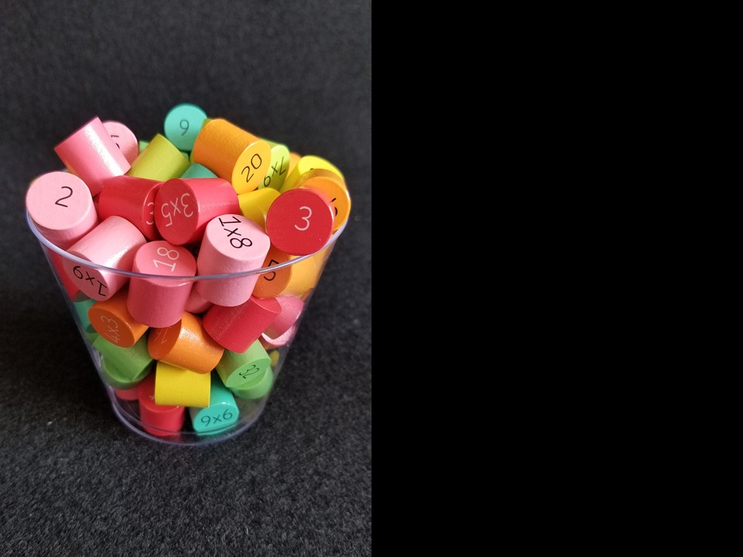
How many pegs
are in the container?
As the clues appear, use the information to narrow the possibilities to a smaller set. After each clue, use estimation again to determine which of the remaining answers is the most reasonable.
Write down your first estimate. After each clue, you’ll see if your estimate is still a possibility. After each clue, if it is no longer possible write down a new estimate – and be prepared to explain why you chose it.
Steve Wyborney
www.stevewyborney.com

Slide 3
Clue #1
Clue #1
The answer is an odd number
between 50 and 100.
Clue #2
Clue #2
The red peg on the top has a 3.
The answer is a multiple of 3.
Clue #3
Clue #3
The blue peg on the top has a 9.
The answer does not include the digit 9.
Bonus Clue: The 9 is important!
Remember it when you come to the end!
Clue #4
Clue #4
The answer is not a multiple of 7.
51 | 52 | 53 | 54 | 55 | 56 | 57 | 58 | 59 | 60
61 | 62 | 63 | 64 | 65 | 66 | 67 | 68 | 69 | 70
71 | 72 | 73 | 74 | 75 | 76 | 77 | 78 | 79 | 80
81 | 82 | 83 | 84 | 85 | 86 | 87 | 88 | 89 | 90
91 | 92 | 93 | 94 | 95 | 96 | 97 | 98 | 99 | 100
51 | 52 | 53 | 54 | 55 | 56 | 57 | 58 | 59 | 60
61 | 62 | 63 | 64 | 65 | 66 | 67 | 68 | 69 | 70
71 | 72 | 73 | 74 | 75 | 76 | 77 | 78 | 79 | 80
81 | 82 | 83 | 84 | 85 | 86 | 87 | 88 | 89 | 90
91 | 92 | 93 | 94 | 95 | 96 | 97 | 98 | 99 | 100
51 | 52 | 53 | 54 | 55 | 56 | 57 | 58 | 59 | 60
61 | 62 | 63 | 64 | 65 | 66 | 67 | 68 | 69 | 70
71 | 72 | 73 | 74 | 75 | 76 | 77 | 78 | 79 | 80
81 | 82 | 83 | 84 | 85 | 86 | 87 | 88 | 89 | 90
91 | 92 | 93 | 94 | 95 | 96 | 97 | 98 | 99 | 100
51 | 52 | 53 | 54 | 55 | 56 | 57 | 58 | 59 | 60
61 | 62 | 63 | 64 | 65 | 66 | 67 | 68 | 69 | 70
71 | 72 | 73 | 74 | 75 | 76 | 77 | 78 | 79 | 80
81 | 82 | 83 | 84 | 85 | 86 | 87 | 88 | 89 | 90
91 | 92 | 93 | 94 | 95 | 96 | 97 | 98 | 99 | 100
51 | 52 | 53 | 54 | 55 | 56 | 57 | 58 | 59 | 60
61 | 62 | 63 | 64 | 65 | 66 | 67 | 68 | 69 | 70
71 | 72 | 73 | 74 | 75 | 76 | 77 | 78 | 79 | 80
81 | 82 | 83 | 84 | 85 | 86 | 87 | 88 | 89 | 90
91 | 92 | 93 | 94 | 95 | 96 | 97 | 98 | 99 | 100
51 | 52 | 53 | 54 | 55 | 56 | 57 | 58 | 59 | 60
61 | 62 | 63 | 64 | 65 | 66 | 67 | 68 | 69 | 70
71 | 72 | 73 | 74 | 75 | 76 | 77 | 78 | 79 | 80
81 | 82 | 83 | 84 | 85 | 86 | 87 | 88 | 89 | 90
91 | 92 | 93 | 94 | 95 | 96 | 97 | 98 | 99 | 100
Clue #5
Clue #5
The answer does not include the digit 7.
Steve Wyborney
www.stevewyborney.com

Slide 4
After seeing the clues, you have narrowed the possibilities to a small set of numbers. Before you see the answer, select your final estimate. Write it down, and explain to someone why you chose that number.
Steve Wyborney
www.stevewyborney.com

Slide 5
81 pegs
The Reveal
Click to see the answer.
Steve Wyborney
www.stevewyborney.com

