Slide 1
“3 Consecutive Penguins”
Steve Wyborney
www.stevewyborney.com

Slide 2
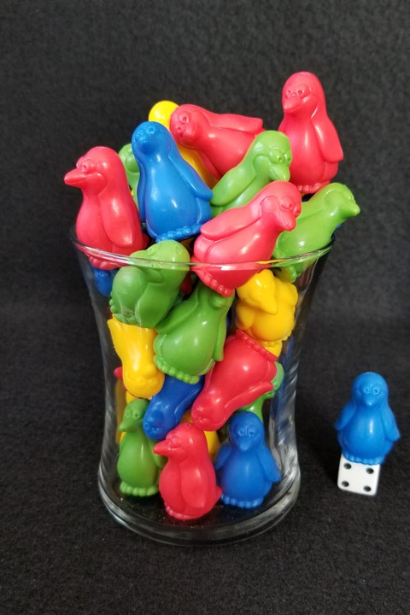
How many penguins are there? That counts the ones in the vase AND the one on the die.
As the clues appear, use the information to narrow the possibilities to a smaller set. After each clue, use estimation again to determine which of the remaining answers is the most reasonable.
Write down your first estimate. After each clue, you’ll see if your estimate is still a possibility. After each clue, if it is no longer possible write down a new estimate – and be prepared to explain why you chose it.
Steve Wyborney
www.stevewyborney.com

Slide 3
How many penguins are there? That counts the ones in the vase AND the one on the die.
Clue #1
Clue #1
The answer is between 32 and 68.
Clue #2
Clue #2
The answer is not a multiple of 4.
Clue #3
Clue #3
Double 19 and eliminate that number.
Also, double 27 and eliminate that number.
Clue #4
Clue #4
Look for sets of 3 consecutive numbers. Eliminate all those numbers.
Clue #5
Clue #5
The answer is not equal to 39 or the number that is number that is 14 more than 39.
31 | 32 | 33 | 34 | 35 | 36 | 37 | 38 | 39 | 40
41 | 42 | 43 | 44 | 45 | 46 | 47 | 48 | 49 | 50
51 | 52 | 53 | 54 | 55 | 56 | 57 | 58 | 59 | 60
61 | 62 | 63 | 64 | 65 | 66 | 67 | 68 | 69 | 70
31 | 32 | 33 | 34 | 35 | 36 | 37 | 38 | 39 | 40
41 | 42 | 43 | 44 | 45 | 46 | 47 | 48 | 49 | 50
51 | 52 | 53 | 54 | 55 | 56 | 57 | 58 | 59 | 60
61 | 62 | 63 | 64 | 65 | 66 | 67 | 68 | 69 | 70
31 | 32 | 33 | 34 | 35 | 36 | 37 | 38 | 39 | 40
41 | 42 | 43 | 44 | 45 | 46 | 47 | 48 | 49 | 50
51 | 52 | 53 | 54 | 55 | 56 | 57 | 58 | 59 | 60
61 | 62 | 63 | 64 | 65 | 66 | 67 | 68 | 69 | 70
31 | 32 | 33 | 34 | 35 | 36 | 37 | 38 | 39 | 40
41 | 42 | 43 | 44 | 45 | 46 | 47 | 48 | 49 | 50
51 | 52 | 53 | 54 | 55 | 56 | 57 | 58 | 59 | 60
61 | 62 | 63 | 64 | 65 | 66 | 67 | 68 | 69 | 70
31 | 32 | 33 | 34 | 35 | 36 | 37 | 38 | 39 | 40
41 | 42 | 43 | 44 | 45 | 46 | 47 | 48 | 49 | 50
51 | 52 | 53 | 54 | 55 | 56 | 57 | 58 | 59 | 60
61 | 62 | 63 | 64 | 65 | 66 | 67 | 68 | 69 | 70
31 | 32 | 33 | 34 | 35 | 36 | 37 | 38 | 39 | 40
41 | 42 | 43 | 44 | 45 | 46 | 47 | 48 | 49 | 50
51 | 52 | 53 | 54 | 55 | 56 | 57 | 58 | 59 | 60
61 | 62 | 63 | 64 | 65 | 66 | 67 | 68 | 69 | 70
Steve Wyborney
www.stevewyborney.com

Slide 4
After seeing the clues, you have narrowed the possibilities to a small set of numbers. Before you see the answer, select your final estimate. Write it down, and explain to someone why you chose that number.
Steve Wyborney
www.stevewyborney.com

Slide 5
37 penguins
The Reveal
Click to see the answer.
Steve Wyborney
www.stevewyborney.com

